Slide 1

MODULAR BUSINESS PROGRAM TRUCKS Orientation for Sales Training Team
MBP TRUCKS
01st August 2019

Slide 2
Program Vision
Company Vision
To be in the Global Top 10 in M&HCV Trucks (>7.5T GVW) and Global Top 5 in M&HCV Buses (8m and above)
in volume terms.
Trucks BU Vision
To achieve market leadership in the Domestic market.
To target one-fourth of volumes from International markets.
MBP Vision
Deliver profitability through customized solutions significantly faster.
Deliver the vision efficiently by lowering complexity to
Manufacture efficiently
Source more effectively
Enhance aftermarket revenues
Improve serviceability

Slide 3



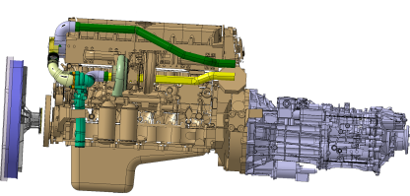
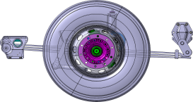
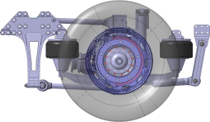

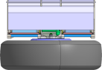
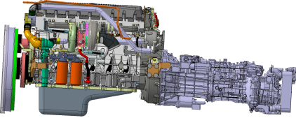
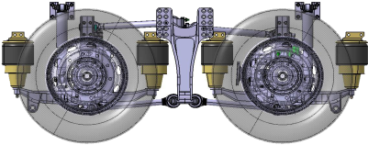
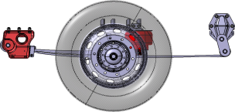
Lego Principle in Modularity
By using 3 simple Lego pieces, a variety of shapes can be formed.
Lego Principle is adopted to achieve modularity for getting more vehicle variants

Slide 4
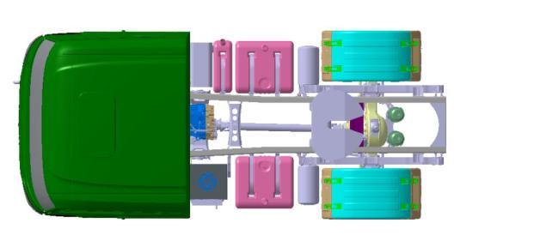
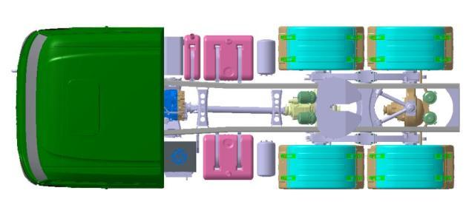
MODULE MODULARITY – VARYING MODULE
Fixed Module
Variable module

Slide 5
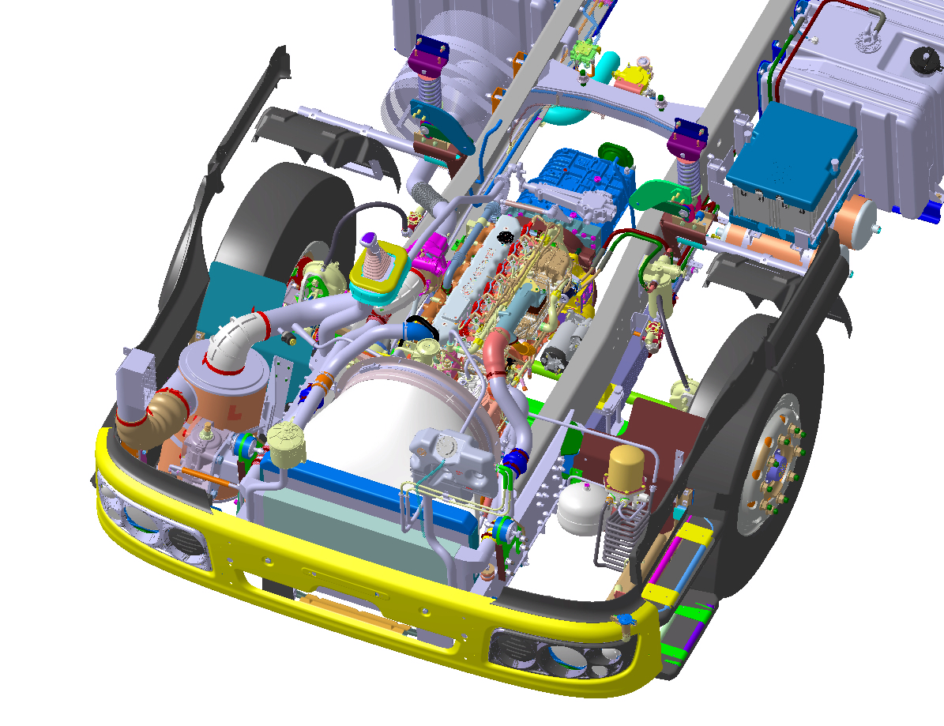
Common Front Module Aggregates For MVP Variants – 4X2,6X4,8X4 & 10X4
Engine position
CSO
Air cleaner
Fuel filter
Steering box
DDU
Purge tank
Compressed air cooling coil
Steering Reservoir
Front cab mount
Cooling system

Slide 6
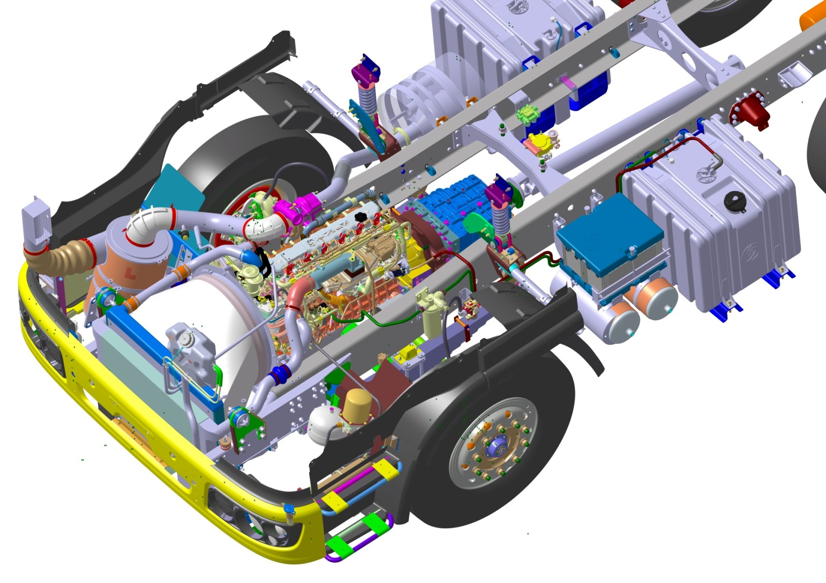
Front Module Interface
Exhaust system
common interface
Cooling system
common interface
Fuel system common interface
Cooling system common interface

Slide 7
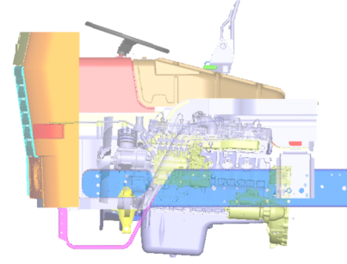
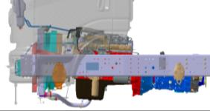
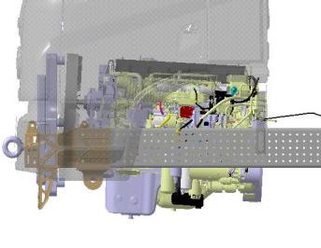
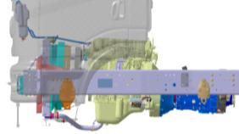
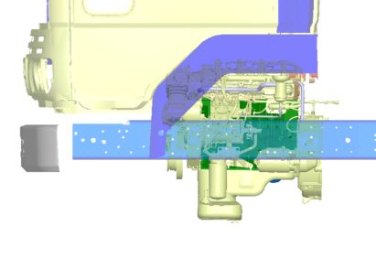
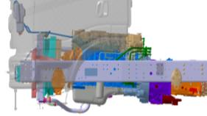
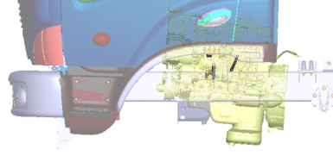
POSITION MODULARITY– Common Engine Position
FVDP-N
H6
CTTP
MVP
H4
N4
H6
N6
ISME
385
251
BT height of cab
N4
385
215
Ecomet
305
N6
564
All Engines packaged in common flywheel housing position
430
NGICV
Different Engine position
Common Engine Position
All possible aggregate to be checked for packaging arrangement to increase the interchangeability
e.g: MVP 4 type of front axle checked with 5 type of engine sumps.
Notes:
7

Slide 8
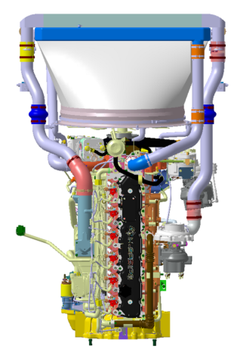
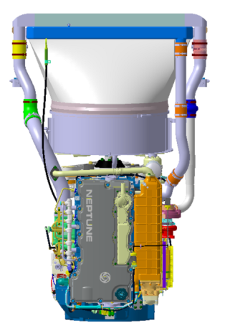
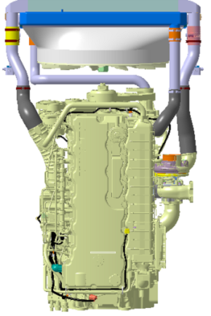
Engines (160hp to 360hp)
H6 engine
N4 engine
N6 engine

Slide 9
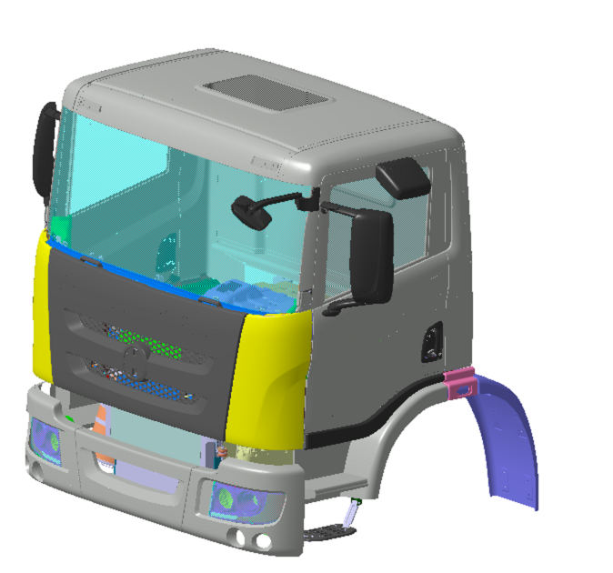
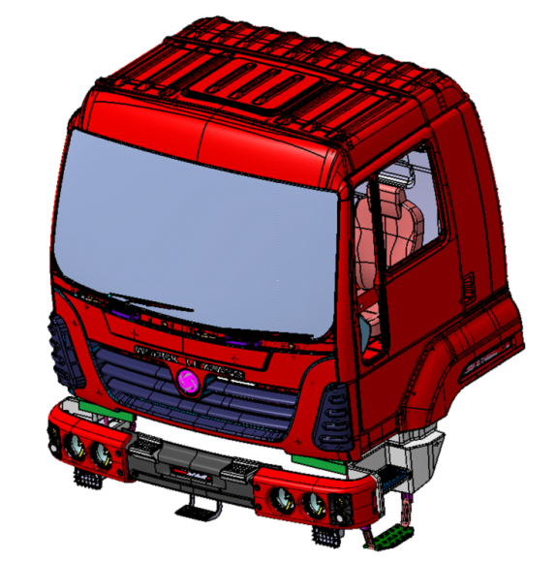
Cabin
NGC family
G91 family
Features
Common Looks
Metal bumper
All-Metal front facia

Slide 10
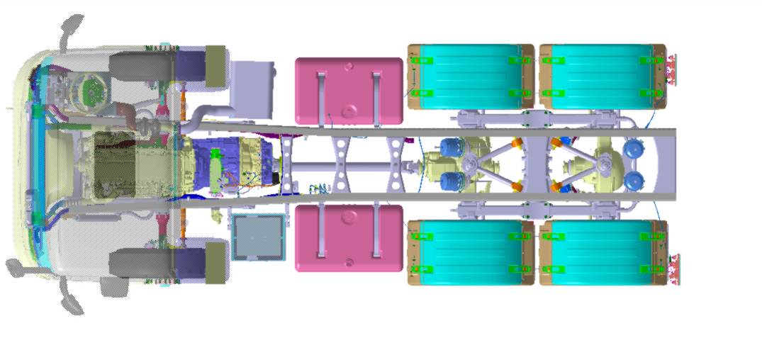
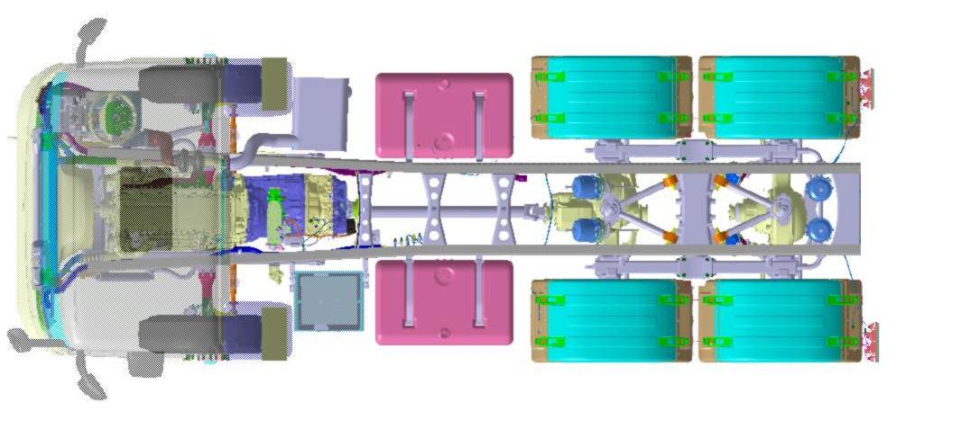
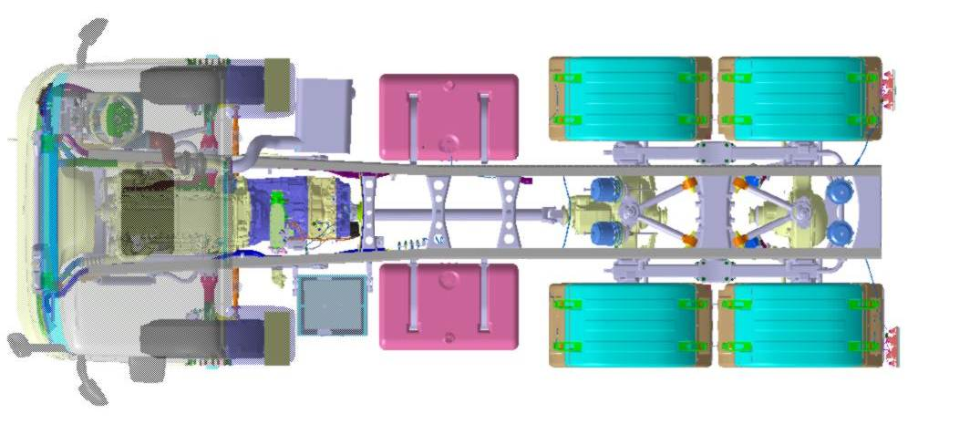
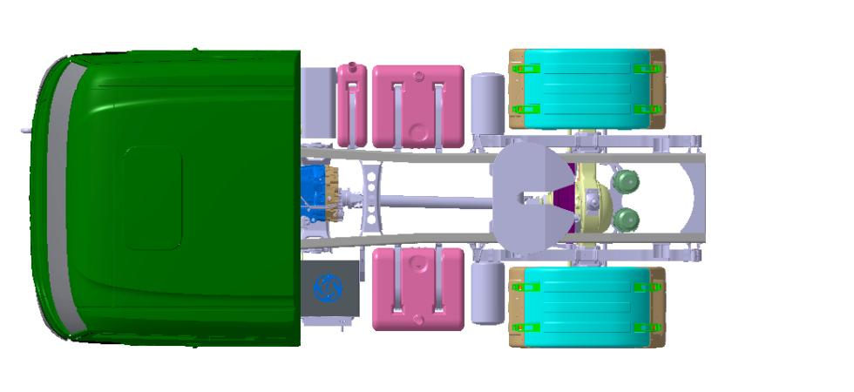
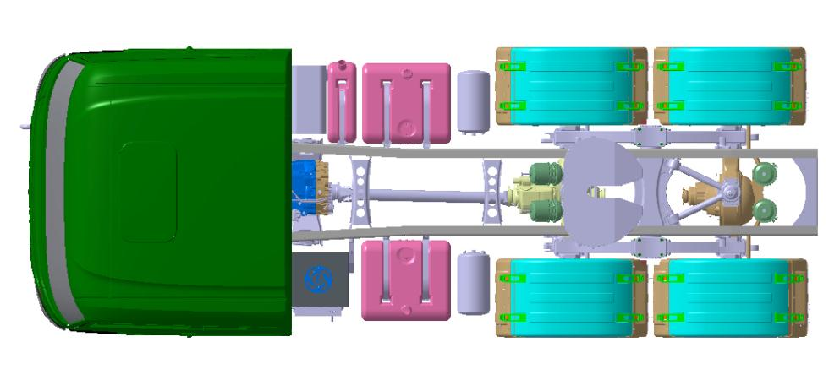

MODULE MODULARITY – VARYING MODULE
Various Wheelbases in 50 mm increments with minimal vehicle changes without change in front module and load module
Easy conversion to different vehicle configurations
Eg 4x2 to 6x4
Changes involved will only be frame, Rear Module - rear electrical module and rear air piping module

Slide 11
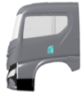
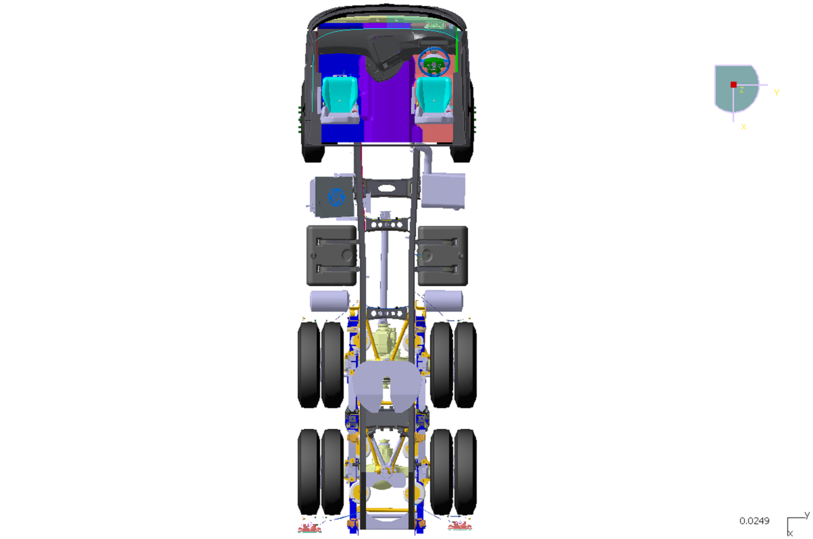

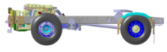
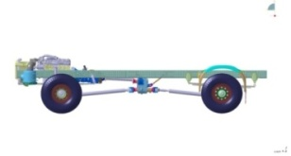

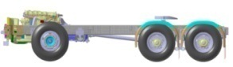
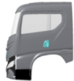
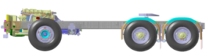

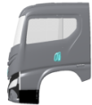
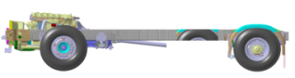
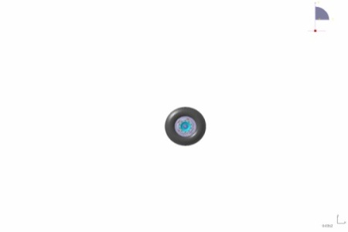

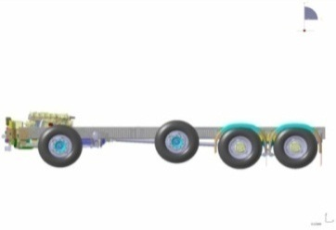
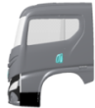
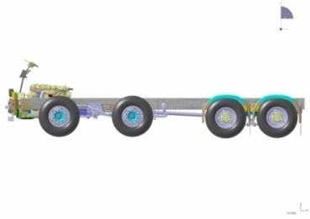

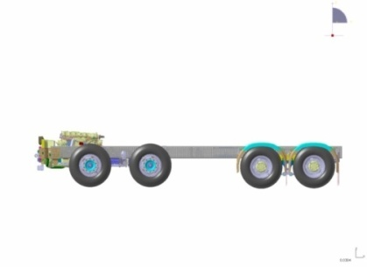

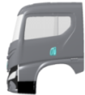
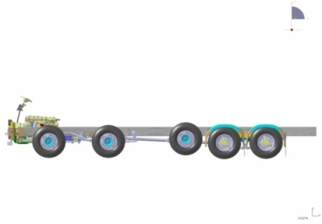
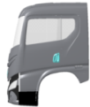


MODULE MODULARITY – WHEEL CONFIGURATION
4x2 4x4 6x4 / 6x2 / 6x2(4/2) 6x6 6x2P 8x2P(2) / 8x4P(2) 8x4(4/2) / 8x4(4) 8x6P(2) / 8x8(4) 10x2P(4) / 10x4P(4) / 10x6P(4) 12x4P(6/2)
RHD
LHD
All vehicle configurations from 4x2 to 12x4 possible
Modular Layout between LHD and RHD
Front module remaining same, the changes required to extend the vehicle family (wheel base) is very minimal

Slide 12
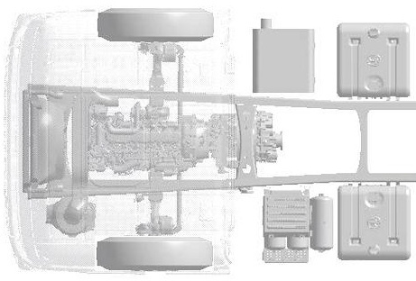
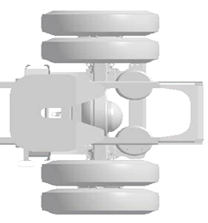
SPLIT MODULARITY – Electrical wiring
BASIC RANGE
Wheel Base 1
Rear Cable 1
BR
CE
CG
FC
FB
C_rear
C9
+
BL
BATTERY
Basic Functions:
Front lights
Rear lights
Trailer lights
Engine ECU
Alternator
Engine start motor
Fuel level
Gearbox signals
Power distributions
Cable colours legend:
red : series COMMON CABLE dotted : engine & battery COMMON CABLE

Slide 13
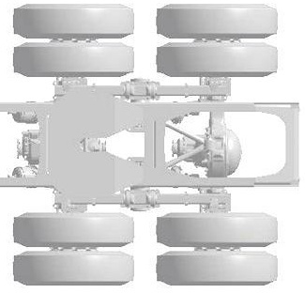
SPLIT MODULARITY – Electrical wiring
BASIC RANGE
Wheel Base 2
Rear Cable 2
BR
CE
CG
FC
FB
C_rear
C9
+
BL
BATTERY
Basic Functions:
Front lights
Rear lights
Trailer lights
Engine ECU
Alternator
Engine start motor
Fuel level
Gearbox signals
Power distributions
red : series COMMON CABLE dotted : engine & battery COMMON CABLE
Cable colours legend:

Slide 14
Pneumatic piping module interface

Slide 15
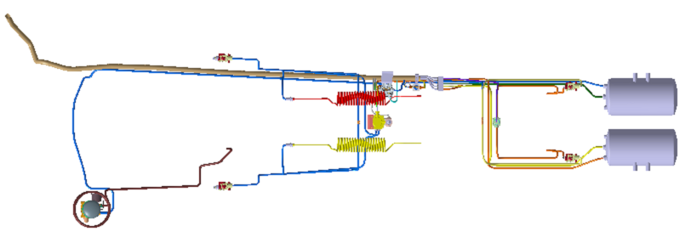
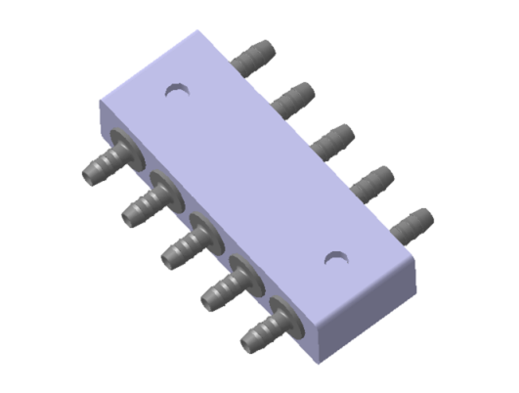
SPLIT MODULARITY – Air piping
Rear module wiring
Front module wiring
Module base design to reduce the part number and inventory
Cost effective connector concept for air piping

Slide 16




POSITION MODULARITY – Air intake system
NGC /FVDP N chassis
692
NGC/FVDP2 chassis
190

Slide 17



INTEGRATION MODULARITY – BOGIE SUSPENSION
Radius rod Mounting brackets (9.5 Kgs x 4)
Single Piece Bogie Bracket
Bogie Brackets
(52 Kgs x 2)
Trunnion Shaft
(63 Kgs)
Proposed Design : Weight - 230Kgs
Advantages :
1.Lesser weight & cost
2. Lesser number of parts and hence assembly time reduction
3. Lesser fasteners and easy maintenance
4 .Lesser failure modes
Bogie Cross member
(85.3 Kgs)
Existing Design : Weight - 290Kgs

Slide 18

INTEGRATION MODULARITY – FRONT NODO BRACKET

Slide 19







SYSTEM MODULARITY – Air intake cleaner
Same  Top Cover | Varying depth Bottom Cover | Different Air Cleaner sizes | Capacity (m³) | Engine
 |  |  | 12-15 | H4-N4
 |  |  | 15-18 | N4-H6
 |  |  | 21-24 | N6-Higher power

Slide 20





SYSTEM MODULARITY – Exhaust muffler
Left
Module
Centre
Module
Right
Module
200 L
160 L
120 L
80 L

Slide 21

DIMENSIONAL MODULARITY – Frame hole pattern

Slide 22








HEIGHT MODULARITY – Frame section height
Modular Frame web height of 180, 225, 270 & 315mm to suit LMH Series
315 mm
270 mm
Total variant of FSM section : 4x3 = 12 (variant)
225 mm
180 mm
5mm
8mm
4mm
6mm
7mm
5mm
45
45
50
6mm
9mm
7mm

Slide 23

HEIGHT MODULARITY – Cooling system radiator
Varying
height
1256
1130
800
680
570

Slide 24










Modular Frame & Cross Member Strategy in MVP
PROFILE MODULARITY- Frame architecture
H = 185 T = 4, 5, 6
Light
H = 225 T = 5, 6, 7
H = 270 T = 7, 8, 9
Light, Medium &
Heavy
H = 315 T = 7, 8, 9
Medium
Reduced Vehicle Weight
Single piece X Member
Cost Reduction
Heavy
Reduced Number of Parts
Reduced Assembly Time
Less Failure Modes

Slide 25


ELIMINATION MODULARITY – Rear suspension
Existing- Rear Suspension with helper spring and helper spring brackets. More no.of parts
Proposed- Rear Suspension without helper spring and helper spring brackets. Reduced no.of parts.

Slide 26


DRAWING MODULARITY – Frame side member
FSM drawing and CAD visualization
without Drawing Modular Approach
FSM drawing and CAD visualization
with Drawing Modular Approach(FSM Modules)

Slide 27






BOM MODULARITY – Front axle system
Current – Assembly Group
GVW
Axle Conf.
Terrain
Wheel base
Wheel Track
Application
Brake Type
Bearing Type
Slack Adjuster type
FRONT AXLE
A No – Level 1
MVP –
Functional Groups
FRONT AXLE
Foundation Brake Group Front
Level 1
Brake Actuation front
Level 1
BRAKES
Foundation Front axle
Level 1
Wheel Hubs – Front
Level 1
Steering Linkages Group – Front
Level 1
GVW
Axle Conf.
Terrain
Brake type
Brake Size
Bearing Type
Axle geometry
Wheel Base Wheel Track
GVW
Application
Slack Adjuster type
GVW
Brake type

Slide 28











BOM MODULARITY – Front axle system
Example:- FA99 Variants
Foundation front Axle | Wheel hub Group Front | Foundation Brake Group Front | Brake Actuation front | Steering Linkages Group
FA99 | Hub 6” & 7” | Brake 7” | Type 20 | SL 1645 TRL
 | Hub 8” | Brake 8” | Type 24 | SL 1705 TRL
1 | 6 | 5 | 7 | 8
FA99 with 8” brake for short WB
FA99 with 7” brake for long WB
Total ~192 combination with 27 variants in 5 modules

Slide 29
Product Configurations
Product Configuration Features
Right Product for the Application and Operating conditions
Product based on Load / Road conditions
Aggregate configurations
Suspension configurations
Tyre configurations
Cabin configurations and levels

Slide 30
MBP Models – 4X2 Haulage
Sub-Segment
4X2
Loading Span
18 ft
20 ft
22 ft
24 ft
26 ft
28 ft
30 ft
32 ft
Engine Power
200HP H6
GB Config’n
S6 36 DD
6MT 86
Rear Axle
Mer 4.63
Mer 5.57
Mer 5.83
DANA 4.63
DANA 5.57
DANA 5.83
Suspension-Frt
SemiEllipt 7000kg
SemiEllipt 8000kg
Parabolic 7000kg
Parabolic 8000kg
Parabolic 10500kg
Suspension-Rear
Semi Ellipt 11500kg
Semi Ellipt 16000kg
Fuel Tank
220 litres
300 litres
375 litres
Dual Tank
+220Litres
Dual Tank
+300Litres
Dual Tank
+375Litres
Cab
G91 S
WIM Eco/ Std
WSM Eco/ Std/ Dlx
New FES
Load Road
L1*R1, L2R1, L2R3, L3R1, L4R1
L1*R1, L3R1, L3R3,L4R1
L1*R1, L3R3
L1*R1
L1*R1
L1*R1
L1*R1
L1*R1, L2R1
ULW
M –6223
CT –5165
U –
B – 5170 (BS6)
M –6251
CT –
U –
N -
M –6279
CT –
U –
N -
M –6307
CT –
U –
N -
M –6335
CT –
U –
N -
M –6363
CT –
U –
N -
M –6391
CT –
U –
N -
M –6419
CT –
U –
N -
Applications
4x2 Model for POL application will be released separately,

Slide 31
MBP Models – 4X2 Haulage
L1*R1 - S636OD, 6mm Frame, L1*Suspension
Loading Spans – 18 / 20 / 22 / 24 / 26 / 28 / 32
L2R3 - 6MT86, 7mm Frame, L2 Suspension
Loading Spans – 18 / 20 / 32
L3 / L4 - 8mm Frame, >L2 Suspension
Loading Spans – 18 / 20 / 22
11 inch Frame on all models

Slide 32
MBP Models – 6X2 MAV
Sub-Segment
6X2
Loading Span
20 ft
22 ft
24 ft
26 ft
28 ft
30 ft
32 ft
Engine Power
200HP H6
250HP N4
GB Config’n
6S 850
6MT86 8.91
6MT86 8.13
9S1110
Rear Axle
Mer MS15i 5.29
Mer MS15i 5.57
Mer MS15i 6.17
Mer MT149.7 5.29
Dana 92S 5.29
Dana 92S 5.57
Dana 92S 6.17
Dana DSHO44 5.29
Suspension-Frt
SemiEllipt 7000kg
SemiEllipt 8000kg
Parabolic 7000kg
Parabolic 8000kg
Suspension-Rear
NRS 22000kg
Slipper End 22T
Fuel Tank
220 litres
300 litres
375 litres
Dual Tank
+220Litres
Dual Tank
+300Litres
Dual Tank
+375Litres
Cab
G91 S
WIM Eco/ Std
WSM Eco/ Std/ Dlx
New FES
Load Road
,
L1*R1, L2R1
L1*R1, L2R1
L1*R1, L2R1
L1*R1
L1*R1
L1*R1, L2R1
L1*R1, L2R1
ULW
M –
CT –
U –
N -
M –7542
CT –
U –
N -
M –7570
CT –
U –
N -
M –7698
CT –6650
U –
N -
M –7626
CT –
U –
N -
M -7654
CT –
U –
N -
M –7682
CT –
U –
N -
M –7710
CT –
U –
N -
Applications
6X2 Model for POL application will be released separately.

Slide 33
MBP Models – 6X2 MAV
L1*R1 - H6-200HP, 6S850, 7mm Frame till 24ft LS, 8mm Frame for 26ft and above, L1*Suspension
SLE Sus for L1* only
Loading Spans – 20 / 22 / 24 / 26 / 28 / 30 / 32
L2R1 - H6-200HP, 6S850, 7mm Frame till 24ft LS, 8mm Frame for 26ft and above, L1*Suspension
Loading Spans – 20 / 22 / 24 / 26 / 28 / 32
6MT86, 7mm Frame, L2 Suspension
Loading Spans – 20 / 22 / 24 / 26 / 28 / 32
L2R3 - 6X4, N4-250HP, 9S1110, 8mm Frame, L2 Suspension
Loading Span – 24

Slide 34
MBP Models – 6X4 MAV
Sub-Segment
6X4
Loading Span
24 ft
Engine Power
200HP H6
250HP N4
GB Config’n
6MT86 8.91
9S1110
Rear Axle
Mer MT1497 6.5
Mer MT1497 5.57
Mer MT1497 5.83
Mer MT610 7.2
Suspension-Frt
SemiEllipt 8000kg
Parabolic 8000kg
Suspension-Rear
NRS
22000kg
Bogie 26000kg
Bogie 38000kg
Fuel Tank
220 litres
300 litres
375 litres
Cab
G91 S
WIM Eco/ Std
WSM Eco/ Std/ Dlx
New FES
Load Road
,
L1*R1, L2R1
L3R1
L2R3
ULW
M –
CT –
U –
N -
M –
CT –
U –
N -
M –
CT –
U –
N -
M –
CT –
U –
N -
M –
CT –
U –
N -
M -
CT –
U –
N -
M –
CT –
U –
N -
M –
CT –
U –
N -
Applications
6X4 for Special Applications like Boom Concrete Pump/ Refueller / Truk mounted crane applications will be released separately.

Slide 35
MBP Models – 6X4 MAV
L2R3 - 6X4, N4-250HP, 9S1110, 8mm Frame, L2 Suspension
Loading Span – 24

Slide 36
MBP Models – 8X2 TS MAV
Sub-Segment
8X2 TS
Loading Span
24 ft
26 ft
28 ft
30 ft
32 ft
Engine Power
200HP H6
250HP N4
GB Config’n
6S 850
6MT86 8.91
6MT86 8.13
Rear Axle
Mer MS197 5.83
Mer MS197 5.57
Mer MS160 5.57
Dana 92S 5.83
Dana 92S 5.57
Suspension-Frt
SemiEllipt 7000kg
SemiEllipt 8000kg
Parabolic 7000kg
Parabolic 8000kg
Suspension-Rear
NRS 22000kg
SlipperEnd 22000kg
Fuel Tank
200 litres
300 litres
375 litres
Dual Tank
+220Litres
Dual Tank
+300Litres
Dual Tank
+375Litres
Cab
G91 S
WIM Eco/ Std
WSM Eco/ Std/ Dlx
WSH Dlx
New FES
Load Road
L1*R1, L2R1, L3R1
L1*R1, L2R1
L1*R1
L1*R1
L1*R1, L2R1
ULW
M –
CT –
U –
N -
M –
CT –
U –
N -
M –
CT –
U –
N -
M –8839
CT –7700
U –
N -
M –8911
CT –
U –
N -
M –8983
CT –
U –
N -
M –9055
CT –
U –
N -
M –9128
CT –
U –
N -
Applications
8x2 Model for POL application will be released separately.

Slide 37
MBP Models – 8X2 TS MAV
L1*R1 - H6-200HP, 6S850/ 6MT86, 7mm Frame, L1*Suspension,
SLE Sus for L1* only
Loading Spans – 24 / 26 / 28 / 30 / 32
L2R1 - N4-250HP, 6MT86-2, 7mm Frame, L2 Suspension
Loading Spans – 24 / 26 / 28 / 30 / 32
L3R1 - N4-250HP, 6MT86-2, 8+6mm Frame, L2 Suspension
Loading Spans – 24

Slide 38
MBP Models – 8X2 LA MAV
Sub-Segment
8X2 LA
Loading Span
24 ft
26 ft
28 ft
30 ft
32 ft
Engine Power
200HP H6
250HP N4
GB Config’n
6S 850
6MT86 8.91
6MT86 8.13
Rear Axle
Mer MS197 5.83
Mer MS197 5.57
Mer MS160 5.57
Dana 92S 5.83
Dana 92S 5.57
Suspension-Frt
SemiEllipt 7000kg
SemiEllipt 8000kg
Parabolic 7000kg
Parabolic 8000kg
Suspension-Rear
NRS 22000kg
SlipperEnd 22000kg
Fuel Tank
200 litres
300 litres
375 litres
Dual Tank
+220Litres
Dual Tank
+300Litres
Dual Tank
+375Litres
Cab
G91 S
WIM Eco/ Std
WSM Eco/ Std/ Dlx
WSH Dlx
New FES
Load Road
L1*R1, L2R1, L3R1
L1*R1,L2R2, L3R2
L1*R1, L2R1
L1*R1
L1*R1, L2R1
ULW
M –
CT –
U –
N -
M –
CT –
U –
N -
M –
CT –
U –
N -
M –8824
CT –7930
U –8160
N -
M –8852
CT –
U –
N -
M –8880
CT –
U –
N -
M –8908
CT –
U –
N -
M –8936
CT –
U –
N -
Applications
8x2 Model for POL application will be released separately.

Slide 39
MBP Models – 8X2 LA MAV
L1*R1 - H6-200HP, 6S850/ 6MT86, 7mm Frame, L1*Suspension
SLE Sus for L1* only
Loading Spans – 24 / 26 / 28 / 30 / 32
L2R1 - N4-250HP, 6MT86-2, 7mm Frame, L2 Suspension
Loading Spans – 24 / 26 / 28 / 30 / 32
L3R1 - N4-250HP, 6MT86-2, 8+6mm Frame, L2 Suspension
Loading Spans – 24

Slide 40
MBP Models – 10X2 MAV
Sub-Segment
10X2 LA
Loading Span
28 ft
30 ft
32 ft
Engine Power
200HP H6
250HP N4
GB Config’n
6MT86 8.91
9S 1110
Final Drive
Mer 5.83
Mer 6.43
Mer 5.63
DANA 5.83
Suspension-Frt
SemiEllipt 7000kg
SemiEllipt 8000kg
Parabolic 7000kg
Parabolic 8000kg
Parabolic 10500kg
Suspension-Rear
NRS 22000kg
SlipperEnd 22000kg
Fuel Tank
375 litres
Cab
G91 S
WIM Eco/ Std
WSM Eco/ Std/ Dlx
WSH Dlx
New FES
Load Road
L1*R1, L2R3
L1*R1, L2R3
L1*R1
ULW
M -9987 CT -9580 U- 9490 N -9610
M -10046 CT -9630
U -
N -9671
M -10066
CT -
U -
N -9700
Applications
10x2 Model for POL application will be released separately.

Slide 41
MBP Models – 10X2 MAV
L1*R1 - H6-200HP/ N4-250HP, 6MT86/ 9S1110, 8mm Frame, L1*Suspension
SLE Sus for L1* only
Loading Spans –28 / 30 / 32
L2R3 - N4-250HP, 9S1110, 8+6mm Frame, L2 Suspension
Loading Spans –28 / 32

Slide 42
MBP Models – 6X4 Tipper
Sub-Segment
6X4
Loading Span
14 CuM
16 CuM
20 CuM
20 CuM LWB
Engine Power
200HP H6
250HP N4
GB Config’n
6MT86 8.91
9S1110
Suspension-Frt
SemiEllipt L2
Parabolic L2
Parabolic >L2
Suspension-Rear
NRS 22T
Bogie 38T
Bogie 48T
Fuel Tank
220 litres
Cab
G91 D
WDL Eco/ Std
New FES
Load Road
,
L1*R1, L2R1, L2R2, L2R3, L3R2, L3R3, L4R2
L1*R1, L2R1, L2R2, L2R3, L3R2, L3R3, L4R2
L1*R1, L2R1, L2R2, L2R3, L3R2, L3R3, L4R2, L5R2
L1*R1, L2R1, L2R2, L2R3, L3R2, L3R3, L4R2, L5R2
ULW
M –
CT –
U –
N -
M –
CT –
U –
N -
M –
CT –
U –
N -
M –
CT –
U –
N -
M –
CT –
U –
N -
M -
CT –
U –
N -
M –
CT –
U –
N -
M –
CT –
U –
N -
Applications

Slide 43
MBP Models – 6X4 Tipper
L1*R1-L2R3 - H6-200HP, 6MT86
L3, L4 N4-250HP, 9S1110, 8mm Frame, Bogie suspension

Slide 44
MBP Models – 4X2 Tractor
Sub-Segment
4X2 40T
4X2 46T
Loading Span
32ft LS
36ft LS
40ft LS
Engine Power
200HP H6
250HP N4
GB Config’n
6MT86 8.91
9S 1110
Rear Axle
Mer MS149.7 6.17
Mer MS160 6.5
DANA 92S 6.17
DANA HDS 6.83
Suspension-Frt
SemiEllipt 7000kg
SemiEllipt 8000kg
Parabolic 7000kg
Parabolic 8000kg
Parabolic 10500kg
Suspension-Rear
Semi Ellipt 11500kg
Semi Ellipt 16000kg
Fuel Tank
300 litres
375 litres
Cab
G91 S
WIM Eco/ Std
WSM Eco/ Std/ Dlx
New FES
Load Road
L1*R1
L1*R1, L2R1
ULW
M –6309
CT –
U –
B –
M –6543
CT –
U –
N -
M –
CT –
U –
N -
M –
CT –
U –
N -
M –
CT –
U –
N -
M –
CT –
U –
N -
M –
CT –
U –
N -
M –
CT –
U –
N -
Applications

Slide 45
MBP Models – 4X2 Tractor
L1*R1 - 6MT86, 7mm Frame, L1* Suspension
Loading Spans – 32 / 36 / 40
L2R1 - 9S1110, 8mm Frame, L2 Suspension
Loading Spans – 32 / 36 / 40
11 inch Frame on all models

Slide 46
MBP Models – 6X4 Tractor
Sub-Segment
6X4 55T
Loading Span
32ft LS
36ft LS
40ft LS
Engine Power
250HP N4
GB Config’n
9S1110
Rear Axle
Mer 6.17
DANA 6.17
Suspension-Frt
SemiEllipt 7000kg
Parabolic 7000kg
Suspension-Rear
NRS 22000kg
Bogie
26000kg
Fuel Tank
375 litres
Cab
G91 S
WIM Eco/ Std
WSM Eco/ Std/ Dlx
New FES
Load Road
L1*R1,
L1*R1, L2R1, L3R1, L3R2
ULW
M – 8078
CT –
U –
N -
M –
CT –
U –
N -
M –
CT –
U –
N -
M –
CT –
U –
N -
M –
CT –
U –
N -
M -
CT –
U –
N -
M –
CT –
U –
N -
M –
CT –
U –
N -
Applications

Slide 47
MBP Models – 6X4 Tractor
L1*R1 - 9S1110, 8mm Frame, L1* Suspension
Loading Spans – 32 / 36 / 40
L2R1, L3R1, L3R2 -9S1110, 8mm Frame, L3 BG Suspension
Loading Spans – 3 Axle Trailers 32ft / 36ft / 40ft
11 inch Frame on all models

Slide 48
Product Add-Ons
Some Additional Product Feature Options
Headlamp grille
Cruise control
Fog Lamps
DGMS requirements (Rev Prox warning, Rear camera, fire retardant system, etc)
Centralized Lubrication System
Tyre pressure monitoring system
iAlert Advanced
And others

Slide 49
Non-Product Add-Ons
Sales Add ons
Financial assistance
Service Products
Extended Warranty Package
Annual Maintenance Contract
ALCOVER Insurance Package

Slide 50

Further Plans
May 2019 – Start of On-Road Trials
Performance Assessment
Driver acceptance and feedback
Durability Assessment
MAV – Max50000 kms covered
Tipper – Max 2400 hrs covered
Tractor – Max 500 kms covered
Seeding to select customer
Primary focus of Applications / Areas based on BS6 diesel availability
Performance assessment
Customer feedback
Customer acceptance
Sale, All India by Q4 of 2019-20
100% BS6 Implementation by 1st April 2020

Slide 51
THANK YOU

